Slide 1


Slide 2
Features of JAVA

Slide 3
PLATFORM INDEPENDENT LANGUAGE
OPERATING SYSTEM 1
JAVA RUNTIME ENVIRONMENT (JRE)
javac
java
JAVA APP
BYTE CODE
JAVA VIRTUAL MACHINE (JVM)
.java
.class
OPERATING SYSTEM 2
JAVA RUNTIME ENVIRONMENT (JRE)
javac
java
JAVA APP
BYTE CODE
JAVA VIRTUAL MACHINE (JVM)
.java
.class

Slide 4
OBJECT ORIENTED PROGRAMMING
  ENCAPSULATION
  INHERITANCE
      Simple Inheritance
      Multi Level Inheritance
      Multiple Inheritance
  ABSTRACTION / POLIMORPHISM

Slide 5
SECURED
  DATA ENCAPSULATION
  NO POINTERS
  NO UNAUTHORISED CODE
ROBUST IN MEMORY MANAGEMENT
MULTI THREADING PROGRAMMING
GUI PROGRAMMING
WEB BASED (APPLETS)
HANDLING RUNTIME ERRORS
NETWORK BASED APPLICATIONS

Slide 6
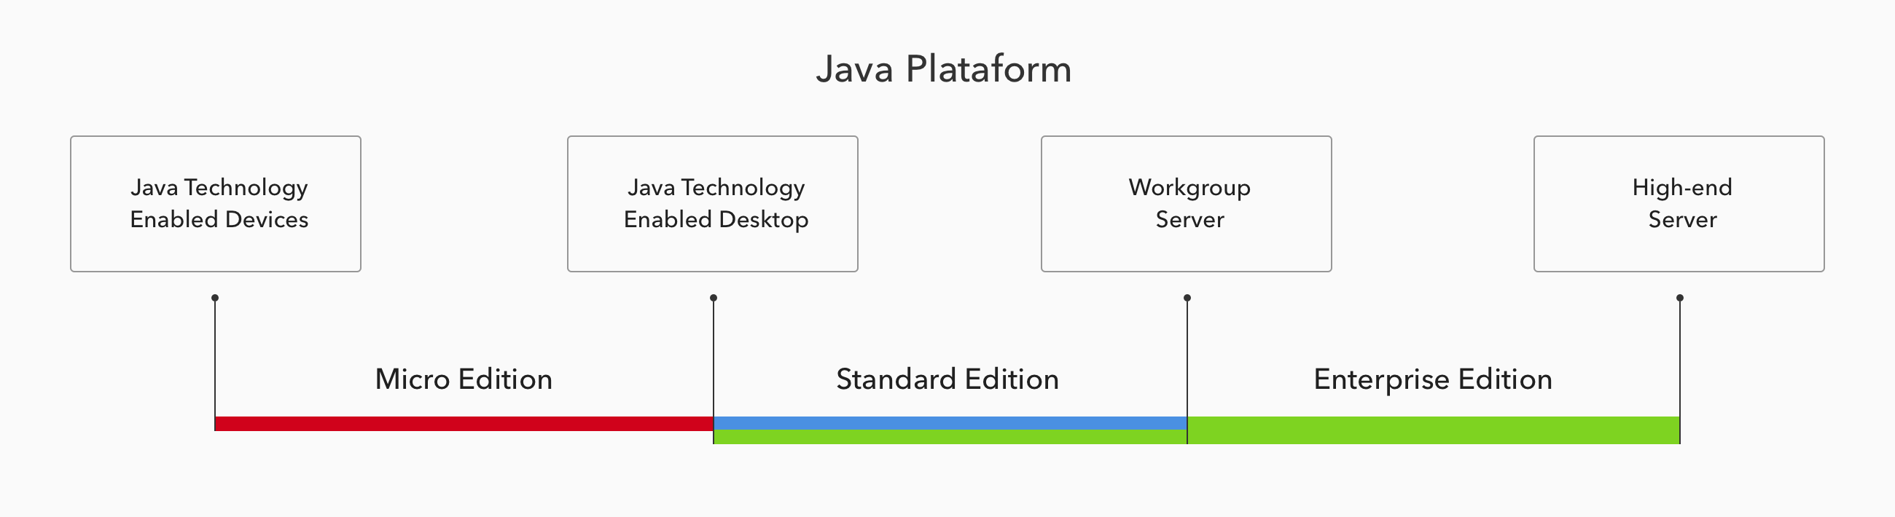
Java Editions

Slide 7
Object Oriented Programming

Slide 8

Simple Programme in JAVA
import java.lang.*;
public class Hello
{
public static void main(String args[])
{
System.out.println(“Hello, Friend”);
}
}

Slide 9
How To Excecute a Programme
Set the path and classpath
  PATH=%PATH%;c:\j2sdk1.4.0\bin
  CLASSPATH=c:\j2sdk1.4.0\lib\*.jar
Save
Hello.java
Compile
prompt:\> javac Hello.java
Execute
prompt:\> java Hello
Output
Hello, Friend

Slide 10
CLASS
Class is blue print or an idea of an Object
From One class any number of Instances can be created
It is an encapsulation of attributes and methods
class
FIGURE
Ob1
Ob3
CIRCLE
Ob2
SQUARE
RECTANGLE

Slide 11
syntax of CLASS
class <ClassName>
{
attributes/variables;
Constructors();
methods();
}

Slide 12
INSTANCE
Instance is an Object of a class which is an entity with its own attribute values and methods.
Creating an Instance
ClassName refVariable;
refVariable = new Constructor();
or
ClassName refVariable = new Constructor();

Slide 13
VARIABLE
It is a reference to a value in the memory.
These are two types..
1. Instance Variables
Ex.: int a=5;
boolean b=false;
2. Reference Variables
Ex.: Circle c=new Circle();
Student stud=new Student();

Slide 14
Data Types
Type Memory Initials Value
byte 1 byte 0
short 2 bytes 0
int 4 bytes 0
long 8 bytes 0
float 4 bytes 0.0
double 8 bytes 0.0
char 2 bytes nil
boolean true / false false

Slide 15
Declaration of Variables
<data_type> <variable> = <initial_value>;
    Example:
    byte a = 5;
    short b = 100;
    int n = 5000;
    long l = 10000;
    float f = 5.5 f;
    double d = 10.5;
    char c = ‘a’;
    boolean b = true;

Slide 16
CONSTRUCTOR

Slide 17
CONSTRUCTOR
It is used to create an instance and initialise the variable values in an instance.
Is a special type of method with class name and without return type.
A constructor without arguments is Default Constructor.
syntax:
ClassName(arguments)
{
  variable initialisation;
  }

Slide 18
Example of Constructor
class Calculator
{
  int a, b;
  Calculator(int a, int b)
  {
  this.a=a;
  this.b=b;
  }
  }

Slide 19
‘this’ keyword
‘this’ is a keyword used to refer to hidden instance variables of present class.
    this.a=a;
It is used to call a constructor from another constructor in overloaded constructors in a class which should be first statement.
    this(a,b);
It is used to call a method from another method in overloaded methods to avoid redundancy of code in methods
    this.addNumbers(a, b);

Slide 20
OVERLOADED CONSTRUCTORS
Having more than one constructor in single class by changing the arguments either with data types or in no. of arguments
Calculator(int a, int b)
{
this.a=a;
this.b=b;
}
Calculator()
{
this(0,0)
}

Slide 21
METHOD

Slide 22
METHOD
Is a function / behavior used to access the attributes / variables of the class.
syntax:
return_type methodName(arguments)
{
…………..
statements
………….
return value;
}

Slide 23
Example of method
int addNumbers(int a, int b)
{
  int c = a + b;
  return c;
}

Slide 24
OVERLOADED METHODS
Having more than one method with same name in a single class by changing in either in no. of arguments or in data types of arguments.
Example:
double divideNumbers(int a, int b)
double divideNumbers(double a, double b)
double divideNumbers(int a, int b, int c)

